Slide 1

CHIME – POC on Dispute Management
Date: 27/08/2024
ThePhoto by PhotoAuthor is licensed under CCYYSA.

Slide 2
Overview of Project Objectives
Features:
Leveraging advanced analytical techniques for enhanced decision-making.
Focused on streamlining chargeback dispute management.
Utilize predictive analytics, automated solutions, historical trend insights, and sentiment analysis.
Benefit:
Enhanced efficiency and reduced resolution times.

Slide 3

Usecases
1
Predictive Analysis of Chargebacks
2
Understanding High Rejection Rate
3
Historical Trend Analysis
4
Automated Summarization

Slide 4

Predictive Analytics for Chargebacks
We developed a system capable of analyzing past chargeback cases to predict liability outcomes based on the evidence provided.

Slide 5
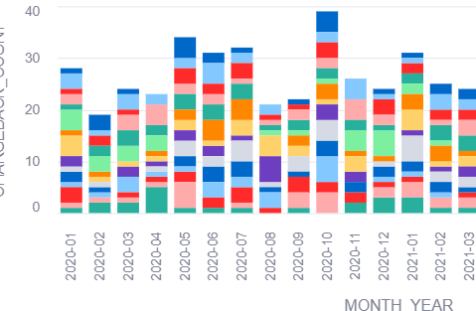



By identifying patterns and trends in historical cases, we can make informed predictions to determine responsibility for chargebacks.
PREDICTIVE ANALYSIS FOR CHARGEBACKS
Features
Parameters
Benefit
Pricing
Advanced classification model utilizing Snowflake ML.
Dispute Type
Product Type
Customer Documentation
Improved accuracy leading to reduced financial losses from unjustified chargebacks.
Cost-saving potential through better outcomes.

Slide 6

Understanding High Rejection Rates
Analyzing the reasons behind a high rejection rate of disputes through sentiment analysis

Slide 7
By employing sentiment analysis, we can examine comments left by customers regarding their disputes to find the most common negative sentiments:
HIGH REJECTION RATE
SENTIMENT
How we do it?
What are the parameters used?
PARAMETERS USED
We're using Snowflake Cortex's SENTIMENT function to implement sentimental analysis on Customer Reviews.
Currently we're using Customer Reviews as a parameter and then further summarizing it to understand the cause of rejection.
BENEFIT
What do we achieve?
How much it will cost?
PRICING
Addressing issues leading to high rejection rates will enhance the customer experience, potentially leading to lower dispute rates in the long term.
We're calculating the cost of using these LLM functions.

Slide 8
Historical Trend Analysis
Analyzing the frequency of disputes logged by each member over time.
Identifying the trends or patterns that may need attention.

Slide 9

By analysing the patterns in history data we are trying to
1
Identify the members who have raised maximum disputes over years in the past
2
Applying various checks to identify the case of risk or issues
3
Finding out the most common reasons of disputes
4
Predicting the members who might raise larger number of disputes in the future

Slide 10
The parameters and features we are using to identify the useful insights as well as risk patterns
Features
Parameters
Data Aggregation to find out number of disputes raised by each member over years
Using Forecast feature of Snowflake ML on the dispute counts to forecast future disputes
CUSTOMER_ID
DISPUTE_ID
CHARGEBACK_DATE
DISPUTE_TYPE
RESOLUTION_TIME
Parameters being used in the process
Analysis and Forecast
Benefits
Enhanced customer experiences by recognizing the common dispute reas
Potential fraud detection and taking preventive measures before significant losses.
Improved risk management and better decision making to expedite resolution process
Useful Insights for Business and customers
Dashboard to visualize trends
Visualization
Yearly Dispute Count by Members
Risk Analysis based on Dispute Count
Dispute Status
Common dispute reasons

Slide 11
Automated Summarization
We developed a tool capable of summarizing the customer statements for dispute along with recommended resolution.

Slide 12
By employing Auto Summarization tool, we can reduce the manual processing time by highlighting the key issues.
FEATURES
We're using Snowflake Cortex's SUMMARIZE function to implement summary on Customer statements.
BENEFITS
Reduces manual processing time by allowing investigators to focus on resolving issues rather than manually reviewing through extensive statements and documentation.
Summarizes and highlights key issues along with recommended resolution.
PARAMETERS USED
DISPUTE_TYPE, PRODUCT_TYPE, STATUS, CUSTOMER_STATEMENT
PRICING
We're calculating the cost of using the LLM functions (SUMMARIZE).

Slide 13

Thank you

Slide 14

Ten tips for better PowerPoint presentations
That’s better!
There are two main types of PowerPoint decks: 1. A visual aid for live presentations; 2. A document to be read while alone. Both are two wildly different animals that require different design strategies and tactics. One should be more of a high-impact storybook. The other should feel like a stylish brochure or magazine.
You need to know the WHY of your presentation to ensure that the content on every slide is contributing to it in a compelling narrative.
1
One main message per slide.
2
For live presentations, no more than six sub-points per slide (the human brain can’t take more in).
3
Use as few words as possible.
4
Make it as visual as possible: Illustrate the ideas. If you use photos, make sure you have the rights to use them. Avoid clip art.
5
6
Ensure readability is easy. Big type. High contrast with background. Not too crowded.
Avoid attention-stealing animations and special transition effects.
7
Every typo or misplaced item weakens your credibility. Find someone else to proof your deck for you—you are blind to your own mistakes.
8
General rule: If something on the page is distracting from the main message, remove it.
9
10
Learn, know, and follow Genpact’s (and/or the client’s) visual brand and writing style guidelines.
We encourage you to go to Genpact’s Genome Storytelling track for more detailed guidance on writing, storytelling, crafting presentations, pitches, PowerPoint, and more.

Slide 15
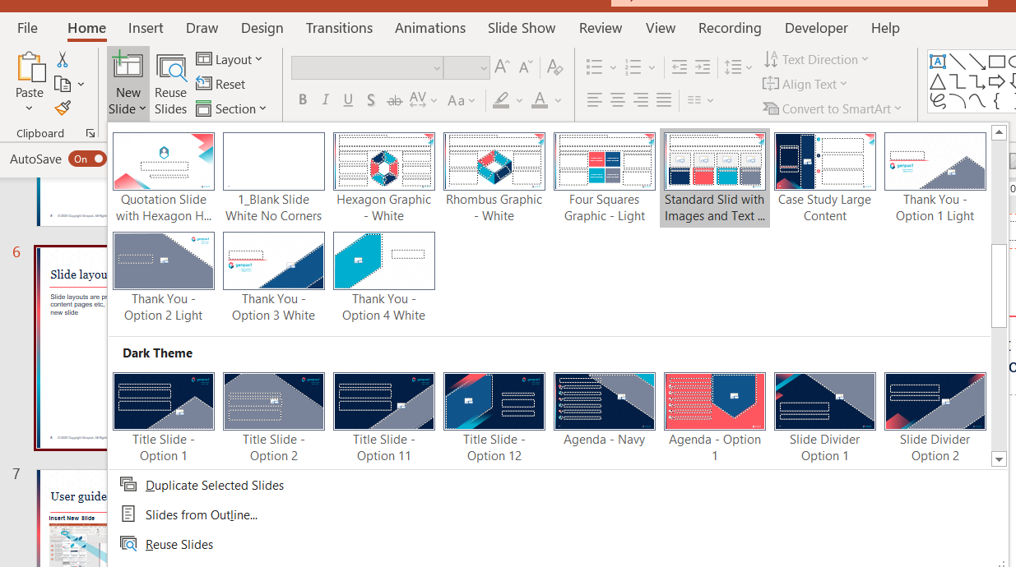
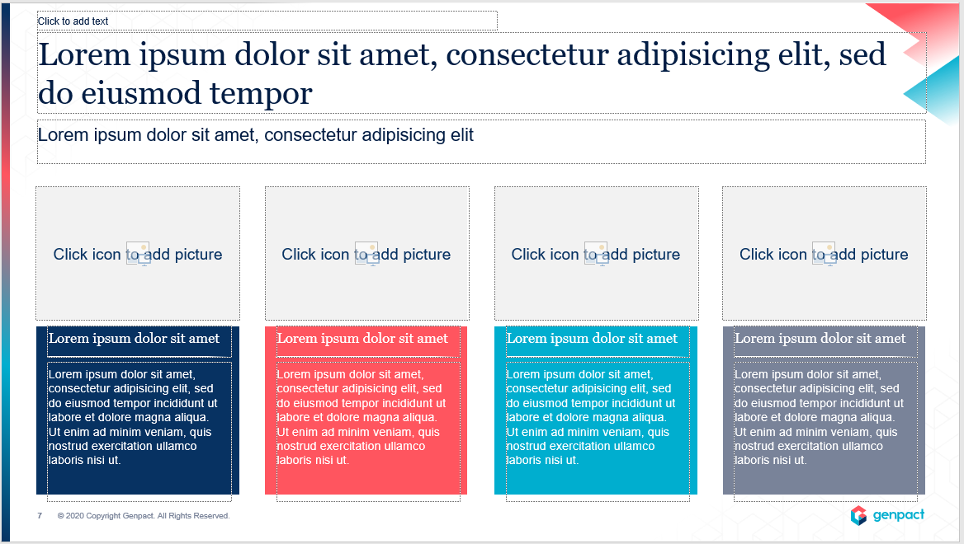
User guide – inserting new slides
Slide layouts are pre-set frameworks set up for different page types, such as titles, slide dividers, standard content pages etc, used when you create a slide. They contain lots of helpful elements and placeholders needed to create your new slide
NOTE:
You can also CHANGE YOUR LAYOUT if your content needs a different set up. To change the layout of an existing slide, go to HOME – LAYOUT and select a new layout to replace the current one.
Another useful tool is to RESET YOUR LAYOUT. This will reset the size, position and format of all the placeholder objects on the slide to their default settings. To reset a layout, go to HOME – RESET.
1
Insert New Slide (Home tab)
2
Select layout
The slide is then added and you can add your content and adapt and format it as required
NOTE: There are light and dark variants for each layout type.

Slide 16


Placeholders
A placeholder is a pre-formatted shape set up on slide layouts. Placeholders and their pre-set format, size and position make it easier to format slides consistently.
Text placeholders – can have different style levels set up. User the Increase/ decrease Indent tool to toggle through the various text style levels to easily apply Genpact style bullet levels. A useful keyboard shortcut is Alt, Shift,, 
Table placeholders – using a table placeholder ensures that your table uses the full space available as a default
Chart placeholders – as with a table, the chart placeholders ensure your charts are sized consistently
Image/picture placeholders – these are useful to define the image shape, size and position. You can use the crop tool to manipulate the shape within the placeholder
NOTE: When copying and pasting content and slides, sometimes your content will ‘jump’ into a different placeholder, eg, the main body bullets will suddenly appear in the top header placeholder. This is a result of slides having different numbers and types of placeholders. Your content won’t disappear, but it may just have been dropped into a different placeholder, so you can cut and paste it into the correct placeholder shape to correct the page

Slide 17
User guide – text styles and bullet lists
Text styles and bulleted lists have been built into all the text placeholders in the template.
To activate the bullet and other text styles:
Insert a new slide by going to HOME – NEW SLIDE and selecting a layout type
If the slide layout has a text or content placeholder, then 5 levels of text formats have been pre-set
To activate the levels, use ALT, SHIFT and the LEFT AND RIGHT ARROW KEYS to toggle through the bullet and style levels
The INCREASE / DECREASE LIST LEVEL buttons on the HOME toolbar can also be used
TOP TIP:
Copy bullet (and other text or shape formats) by using:
CTRL, SHIFT C – to copy formats
Then use
CTRL SHIFT V – to paste formats
Level 1 – Body text
Level 2 – Bullet 1
Level 3 – Bullet 2
Level 4 – Bullet 3
Level 5 – Body heading

Slide 18
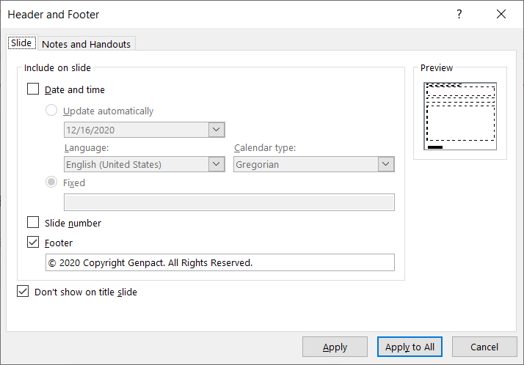
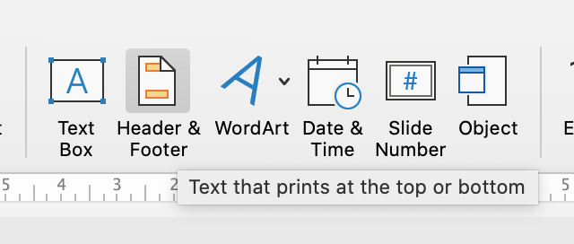
Footers
Use the Header & Footer tools to update the copyright information
Go to Insert – Header & Footer

Slide 19

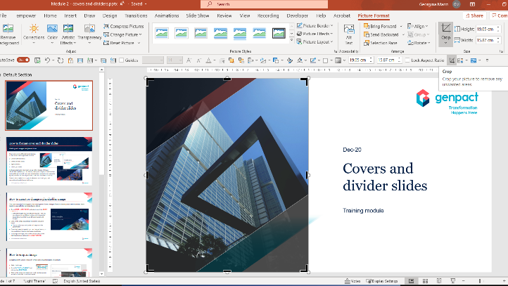


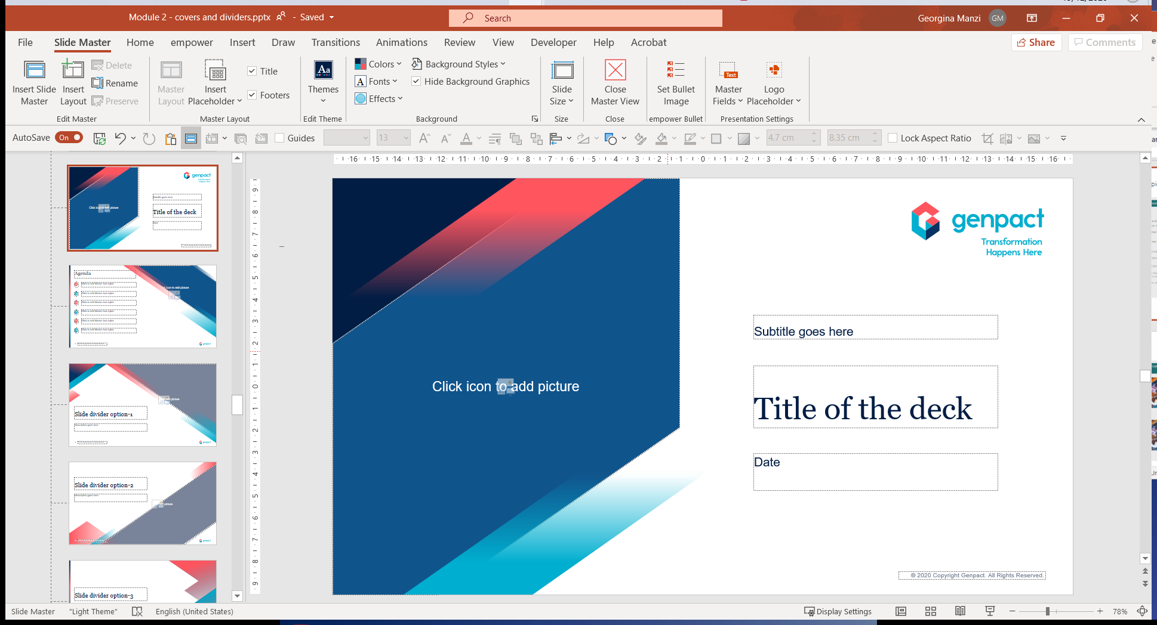
User guide – changing an image on cover/divider slides
1
Insert a slide layout and click on the picture placeholder to insert a new image from your file locations or downloaded from the brand portal.
2
If required, use the Picture Format – Crop tool to position and size the image within the frame.
4
3
To apply the fade shapes, you will first need to copy them from the master slides.
To do so, got to View – Slide Master and copy (CTRL C) the shapes.
Then click on Close Master View.
Finally, back at the live slide, paste the fade shapes over the image (CTRL V).

